Slide 1


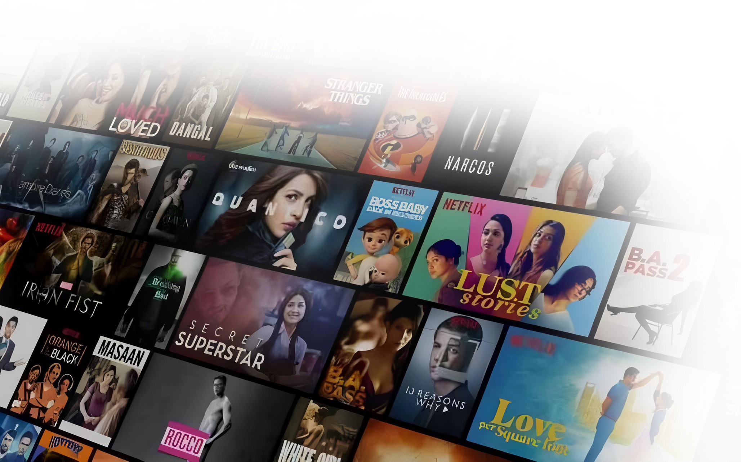
SHREYA PANDEY
NETFLIX CONTENT
Analysis

Slide 2

TABLE OF CONTENTS
01
Introduction
04
SQL Queries
02
Dataset Overview
05
Findings & Visuals
03
Objectives
06
Conclusion

Slide 3
INTRODUCTION
Netflix has revolutionized the entertainment industry, offering a massive library of movies and TV shows across different genres and regions. With thousands of titles available, understanding content trends is crucial for maintaining its competitive edge
This analysis explores Netflix’s content catalog, focusing on key aspects such as production trends, audience preferences, and content performance. Using SQL, we uncover insights into how Netflix's library evolves over time, which genres dominate, and how different factors influence ratings and popularity.
By analyzing this data, we gain a deeper understanding of how Netflix curates its content and adapts to changing viewer demands.

Slide 4
DATASET OVERVIEW
For this analysis, we used two datasets: Titles and Credits, containing detailed information about Netflix content and the people involved in it.
🎬 Titles Dataset (titles.csv)
Contains 5,000+ unique titles with 15 key attributes, including:
Title Information – ID, name, type (Movie/TV Show), description
Release Details – Release year, runtime, age certification
Content Classification – Genres, production countries, seasons (for TV shows)
Performance Metrics – IMDB & TMDB scores, votes, popularity
🎭 Credits Dataset (credits.csv)
Contains 77,000+ actor and director credits with 5 key attributes:
Person Details – ID, name, role (ACTOR/DIRECTOR)
Title Connection – The title ID associated with the person
Character Information – Name of the character played (for actors)
These datasets provide a comprehensive view of Netflix’s content, allowing us to analyze content trends, audience engagement, and talent impact.

Slide 5

OBJECTIVES
This project aims to explore Netflix’s vast content library using SQL queries to uncover valuable insights related to content trends, audience engagement, and market expansion.
🔹 Content Strategy & Growth
🔹 Talent & Star Power Analysis
Analyze Netflix’s year-over-year content production across genres.
Identify the most popular genres based on IMDB & TMDB scores.
Examine runtime variations across different genres.
Identify the top 10 actors with the most Netflix appearances.
Determine which directors consistently produce high-rated content.
Analyze actors who work across multiple genres and their ratings.
🔹 Audience Targeting & Engagement
🔹 User Engagement & Performance Metrics
Determine which age certification categories receive the highest ratings.
Analyze the correlation between runtime and audience scores.
Identify the most popular content durations based on votes and ratings.
Compare Netflix Originals vs. third-party content in terms of ratings.
Examine whether older movies (pre-2000) perform better or worse.
Identify which content type (Movies vs. TV Shows) has higher engagement.
🔹 Competitive Analysis & Market Expansion
Discover which countries produce the highest-rated content.
Analyze the distribution of IMDB scores across production countries.
Track Netflix’s dependence on international content over time.

Slide 6
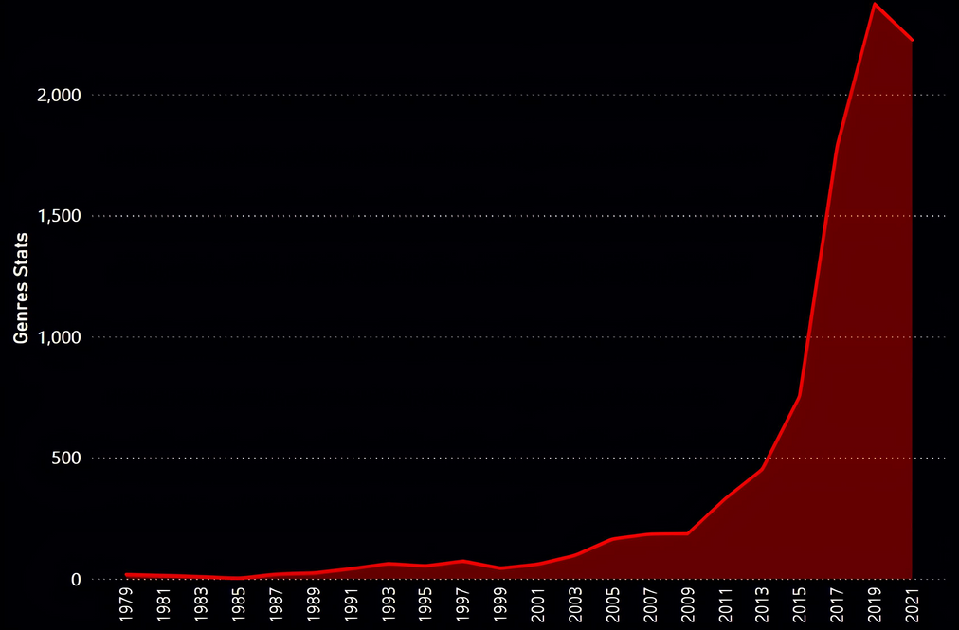
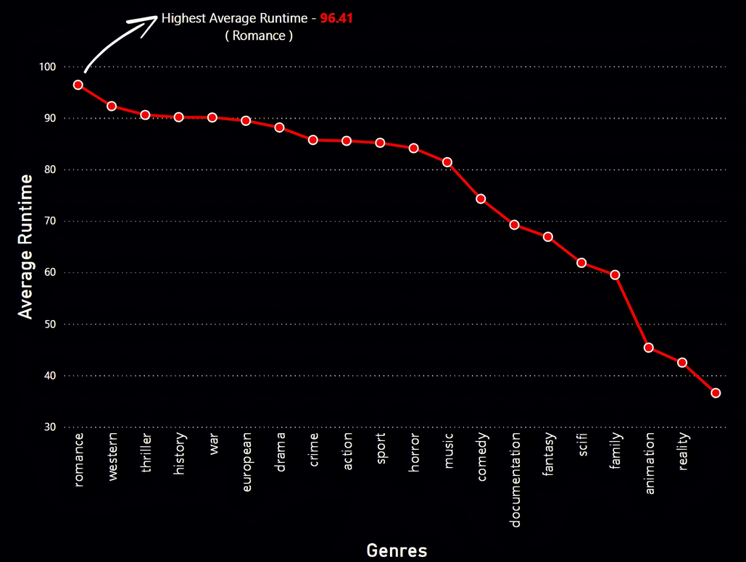

SQL QUERIES
Content Strategy & Growth
Top 5 Genres Based on Avg Imdb and Tmdb
PREV_YEAR_PRODUCTIONS AS (
SELECT
RELEASE_YEAR,
GENRES,
TOTAL_TITLES AS CURRENT_YEAR_TITLES,
LAG(TOTAL_TITLES) OVER (PARTITION BY GENRES ORDER BY RELEASE_YEAR) AS PREV_YEAR_TITLES
FROM GENRE_PRODUCTION
)
SELECT
RELEASE_YEAR,
GENRES,
CURRENT_YEAR_TITLES ,
PREV_YEAR_TITLES,
CURRENT_YEAR_TITLES - PREV_YEAR_TITLES AS YOY_GROWTH,
CONCAT(CAST(ROUND((CURRENT_YEAR_TITLES - PREV_YEAR_TITLES)*100/CURRENT_YEAR_TITLES,2) AS VARCHAR(255)),'%') AS GROWTH_PERCENTAGE
FROM PREV_YEAR_PRODUCTIONS;
GENRES
TOTALS
AVG IMDB
AVG TMDB
History
254
7.13
7.19
War
163
7.07
7.08
Documentation
952
7.01
7.04
Animation
705
6.7
7.33
Sports
170
6.65
7.02
Runtime variations across different genres
Western, romance, and Thriller genres have the longest average runtimes , while animation, family, and reality have the shortest.
Year over Year content production across genres increases

Slide 7

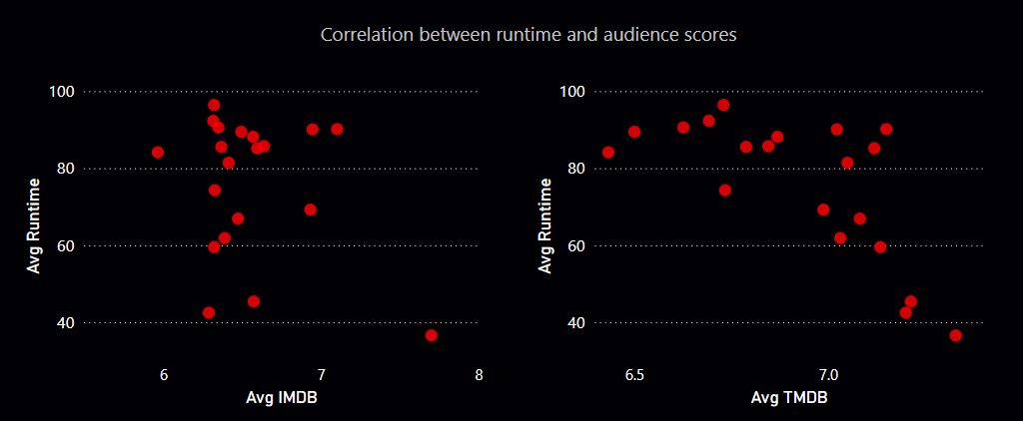
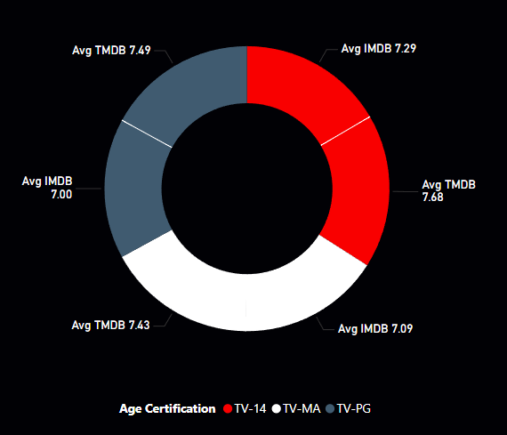
Audience Targeting & Engagement
No Correlation between Runtime and audience scores.
Most popular content durations based on votes and ratings
TOTAL IMDB
VOTES
RUNTIME
AVG IMDB
AVG TMDB POP.
AVG TMDB
194
155.68
7.9
7.88
1146825
111
109.71
6.23
6.47
1576282
101
67.39
5.99
6.49
2038715
18
58.22
6.6
6.7
2705
99
54.08
6.18
6.58
998055
187
53.53
8
7.8
87515
131
52.97
6.45
6.53
1253809
79
52.35
6.27
6.45
37240
115
50.03
6.09
6.36
539591
117
49.63
6.62
6.72
2922886

Slide 8
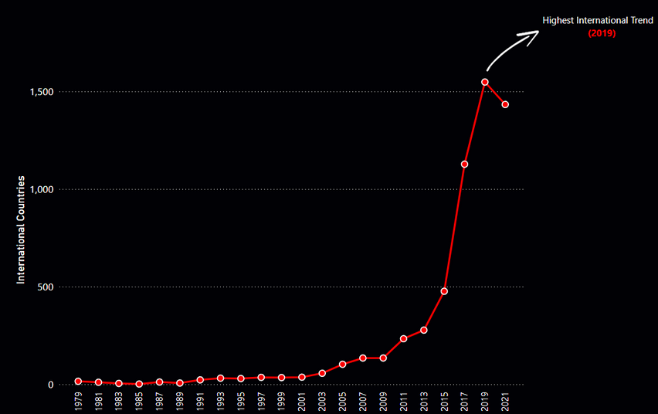
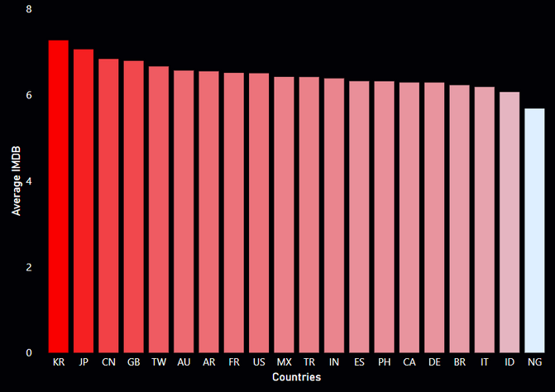
Top countries which produce the highest-rated content
Competitive Analysis & Market Expansion
SELECT TOP 10
PRODUCTION_COUNTRIES,
COUNT(*) AS TOTAL_CONTENTS,
ROUND(AVG(CAST(IMDB_SCORE AS FLOAT)),2) AS AVG_IMDB_SCORE,
ROUND(AVG(CAST(TMDB_SCORE AS FLOAT)),2) AS AVG_TMDB_SCORE
FROM COUNTRY_SPLIT
GROUP BY PRODUCTION_COUNTRIES
ORDER BY TOTAL_CONTENTS DESC,
AVG_IMDB_SCORE DESC,
AVG_TMDB_SCORE DESC;
COUNTRY
AVG IMDB
AVG TMDB POP.
AVG TMDB
US
2135
6.53
6.85
IN
568
6.41
6.42
GB
373
6.8
6.89
JP
254
6.97
7.37
FR
231
6.44
6.6
ES
196
6.36
6.68
CA
194
6.34
6.73
KR
193
7.22
7.7
DE
128
6.39
6.51
MX
116
6.36
6.93

Slide 9
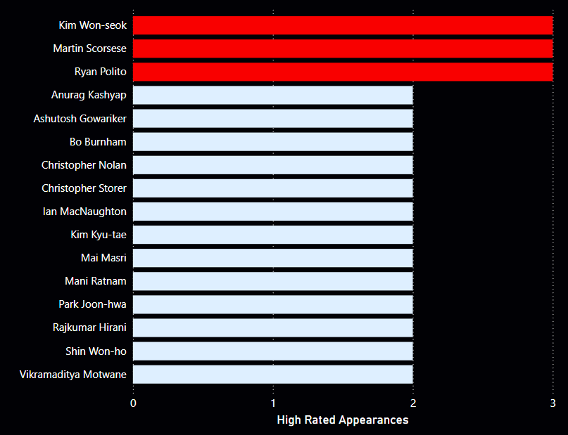




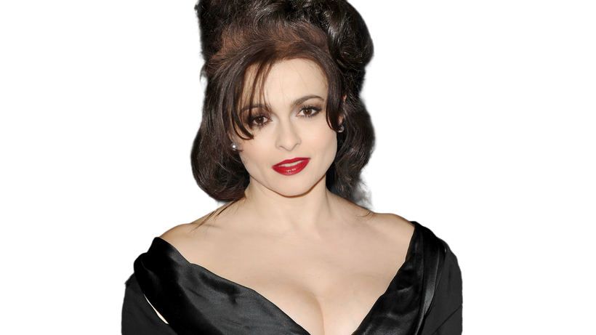




Talent & Star Power Analysis
Top 10 actors with the most Netflix appearances.
Top 10 Consistently High-Rated Directors
Top 10 Multi-Genre Actors with Avg. IMDb Scores
TOTAL
APPEARANCES
AVG IMDB
TOTAL
GENRES
AVG IMDB
ACTOR NAME
ACTOR NAME
Boman Irani
25
6.44
Bobby Cannavale
15
6.87
Kareena Kapoor Khan
25
6.28
Helena Bonham Carter
15
7.52
Shah Rukh Khan
23
6.54
Chris Pine
14
7.26
Takahiro Sakurai
21
6.87
Gary Oldman
14
6.92
Amitabh Bachchan
20
6.59
Hiroki Yasumoto
14
7.78
Paresh Rawal
20
6.58
John F. Kennedy
14
7.35
Priyanka Chopra Jonas
20
6.61
Nicole Kidman
14
6.48
Anupam Kher
19
6.05
Patton Oswalt
14
6.69
Junichi Suwabe
19
7.11
Rob Corddry
14
6.24
Nawazuddin Siddiqui
19
7.19
Rose Byrne
6.7
14
Boman Irani
Shah Rukh
Khan
Kareena Kapoor Khan
Kim Won -seok
Ryan Polito
Martin Scorsese
Helena Bonham Carter
Chris Pine
Bobby Cannavale

Slide 10
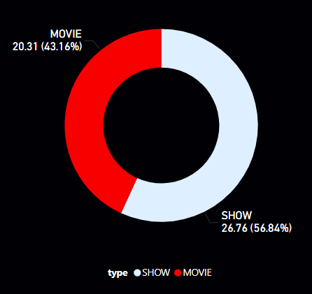
Netflix Originals vs. Third-Party
AVG IMDB VOTES
AVG IMDB
CONTENT TYPE
6.53
NETFLIX-ORIGINAL
46577.71
THIRD-PARTY CONTENT
Content Type with Highest Engagement
6.5
7854.66
Netflix Originals have a slightly higher average IMDB score and significantly more audience engagement with votes compared to third-party content.
Older vs. Newer Movies
AVG TMDB
POPULARITY
AVG IMDB
MOVIE CATEGORY
AVG TMDB
6.78
6.63
11.22
OLDER (PRE-2000)
NEWER (2000 & LATER)
6.22
6.46
20.75
Older (pre-2000) movies have higher average IMDB and TMDB scores, while newer content (2000 & later) shows greater TMDB popularity.

Slide 11

CONCLUSION
Netflix Originals have slightly better ratings and significantly more audience engagement than third-party content.
Older movies (pre-2000) have higher average ratings but are less popular than newer ones.
TV Shows outperform movies in engagement (TMDB popularity: 26.76 vs. 20.31).
No clear correlation between runtime and ratings, though longer runtimes (194 mins) often receive higher votes and scores.
Top genres like History, War, and Documentaries have the best ratings.
South Korea, Japan, and the UK produce the highest-rated content.
Versatile actors and renowned directors consistently deliver high-quality content.
Action Points:
Focus on regional high-rated content,
Promote long-form, high-performing movies,
Invest in TV Shows and Originals,
Collaborate with top-rated actors and directors.

Slide 12


THANK YOU
📂 View Full Project on GitHub
🔗 Connect with me on LinkedIn

